Slide 1


VENUE REGISTRATION SYSTEM
Batch : 14

Slide 2
Venue Registration System:
A place to find the perfect venue for your event
Batch : 14
231FA04512 : SUGGULA LAKSHMI SATVIKA
231FA04570 : KOTA RENUKA DEVI
231FA04587 : MODUGUMUDI NAMRATHA KRISHNA
231FA04B55 : ALAPATI SAI VAMSI KRISHNA

Slide 3

Introduction
Our project, “Venue Registration System”, is designed to help you find the perfect venue for your events effortlessly. Simply provide details such as the type of event, location, and capacity, and our system will recommend the most suitable venues that match your requirements, making the process quick and effortless!

Slide 4
The traditional venue selection process of manually searching for a venue is time consuming and you may miss some other venues that are better suited. Existing online venue registration systems, can be inefficient, requiring users to manually browse, make multiple inquiries, and compare venues without proper filtering. Many platforms fail to consider user preferences like location, capacity, while asking for things such as logins and subscriptions, leading to less optimal venue choices and time-consuming decision-making.
Our venue registration system is straightforward and simplifies the searching process by providing venue recommendations based on user’s preferences, reducing manual effort, making this more efficient for venue selection.
motivation
cafeteria

Slide 5
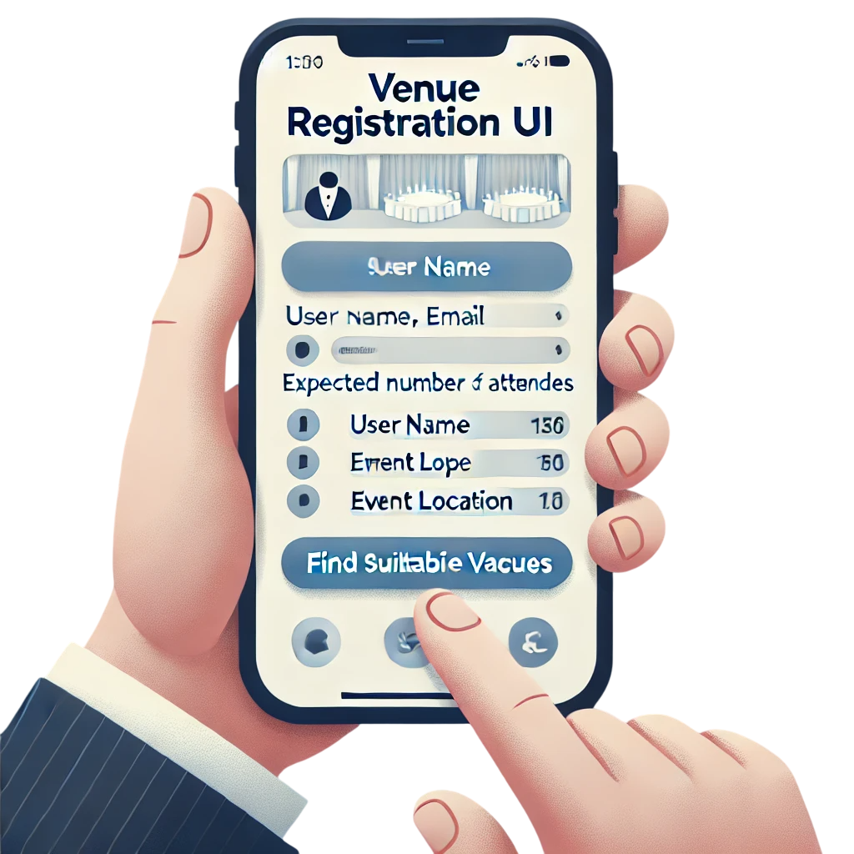
Objectives
To Create an Efficient Venue registration system
Make venue searching easy
Increase user satisfaction
Provide only the most suitable venues
Provide a platform with user friendly interface

Slide 6
Role of Front-End and Back-End in our project
Front-End
Back-End
Previous registrations: Display the user’s previous registrations
Take User preferences: Take the user preferences
Display Venues: Display the suitable Venues
Take user preferences: Take user preferences from the front-end
Access the Database: Access the database for info about venues
Send suitable venues: Send the suitable venues as per the user’s preferences to the front-end

Slide 7
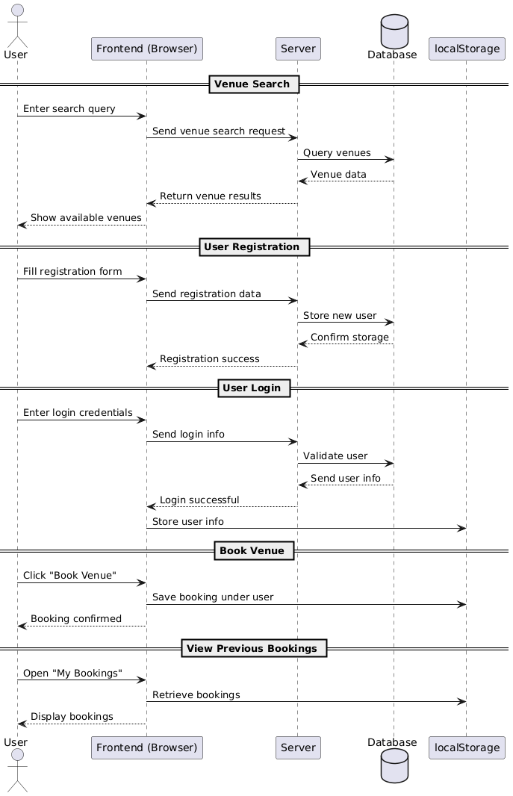
Sequence Diagram

Slide 8
Tools and Technologies
Frontend
HTML
CSS
JavaScript
React
Backend
Node.js
Express
MongoDB Compass
Other Tools
GitHub
Postman

Slide 9
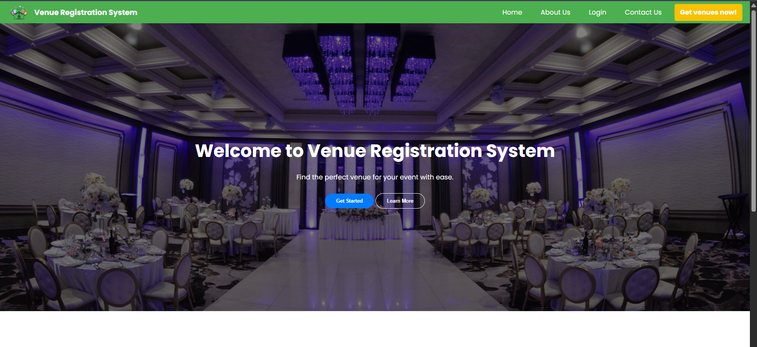
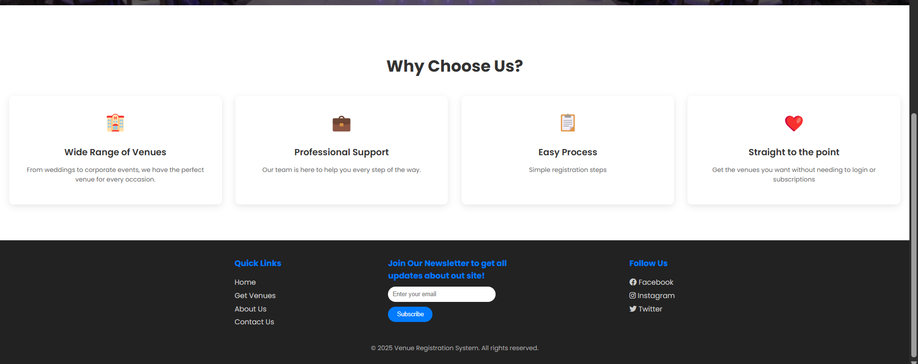
Outputs
HOME PAGE

Slide 10
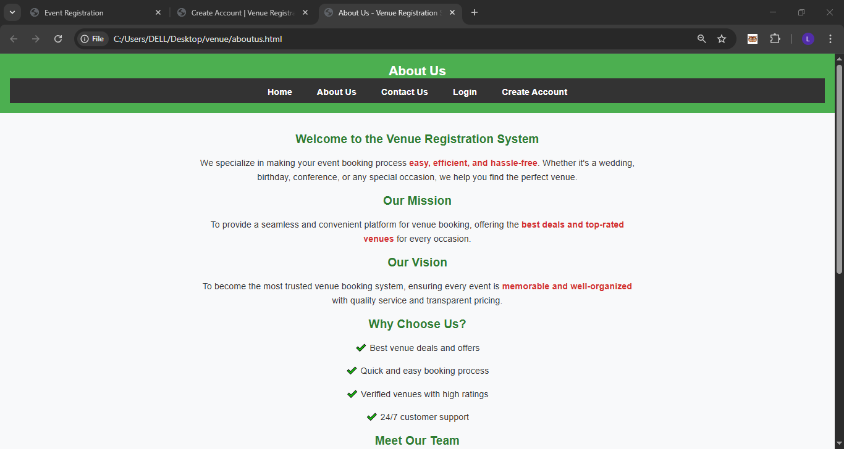
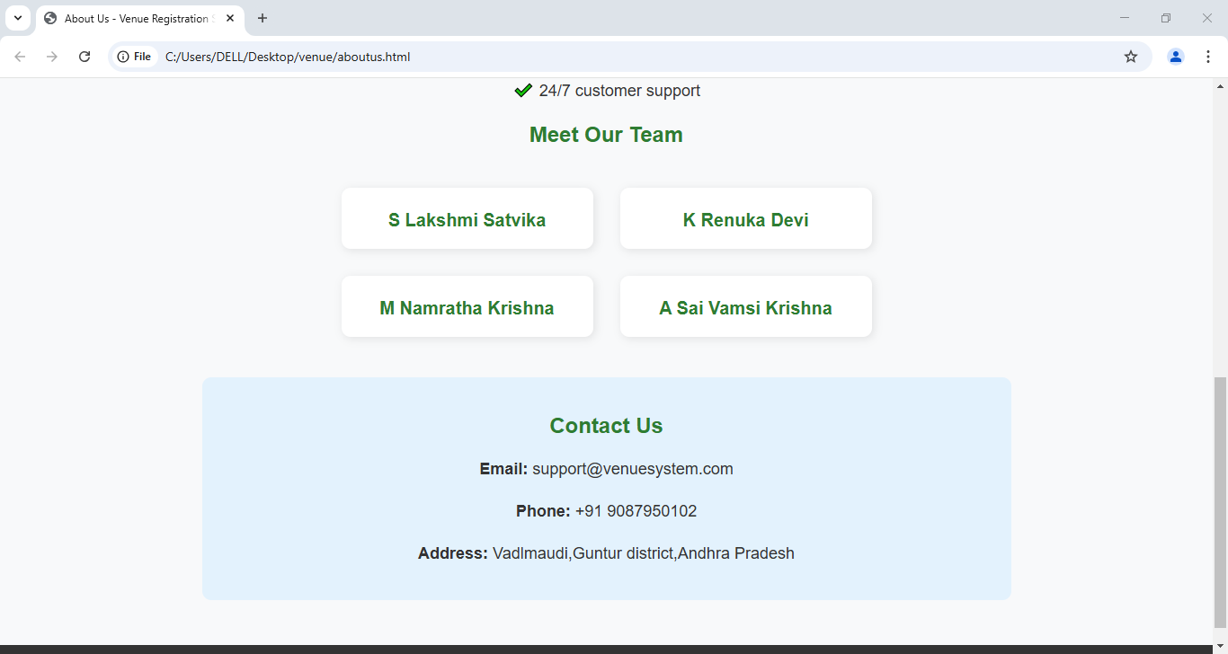
ABOUT US PAGE

Slide 11
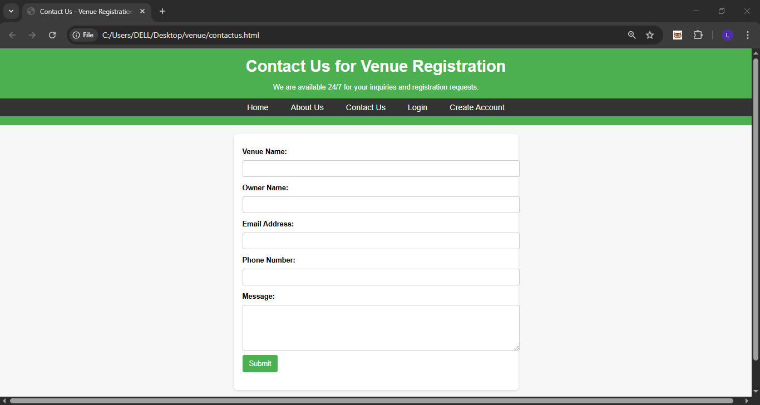
CONTACT US PAGE

Slide 12
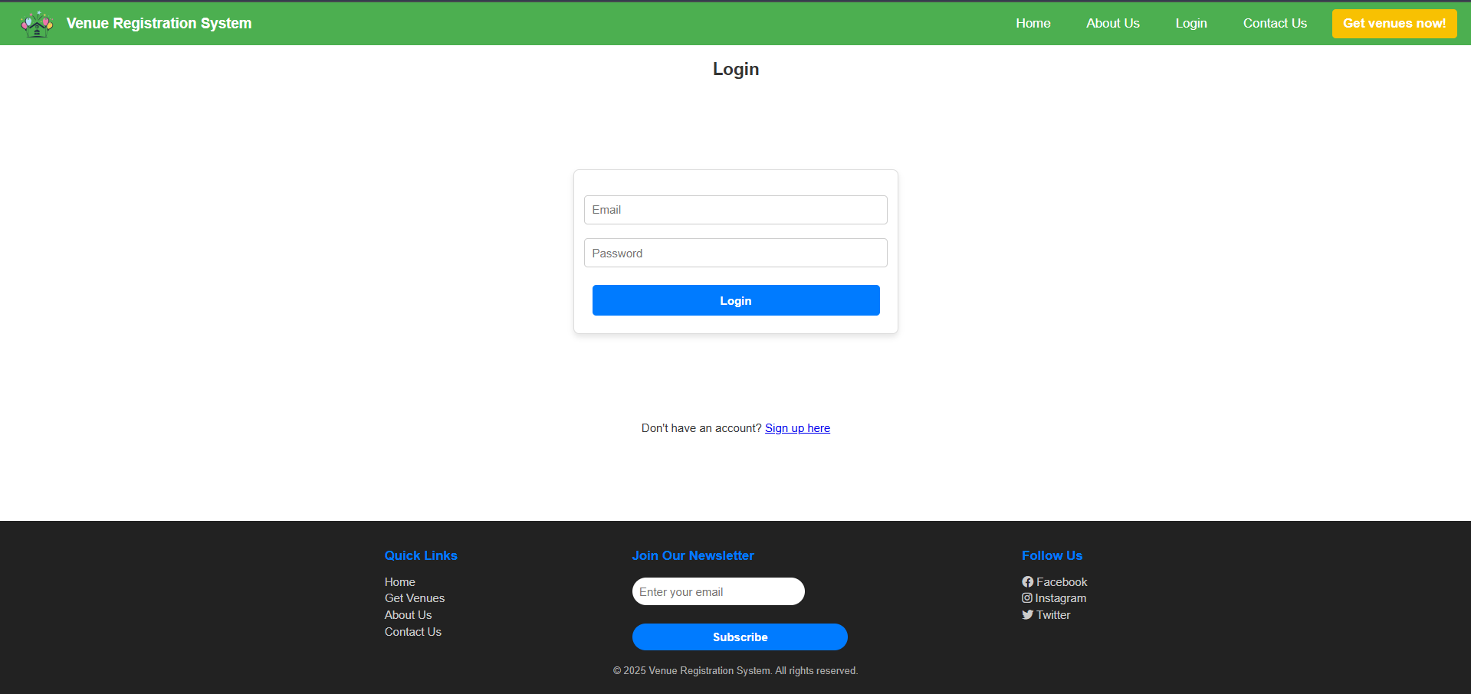
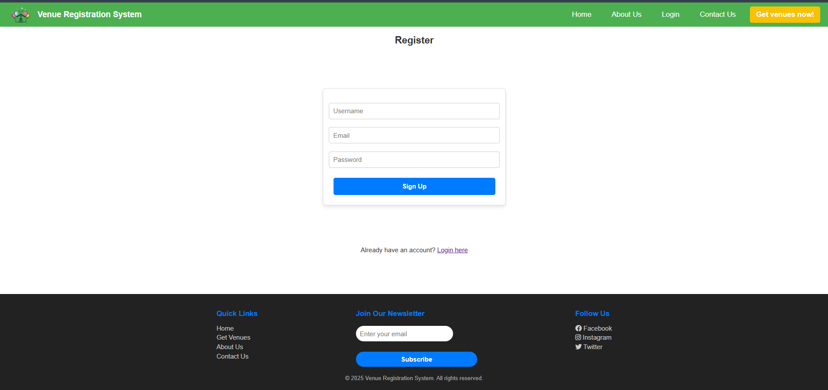
Login Page
Register Page

Slide 13
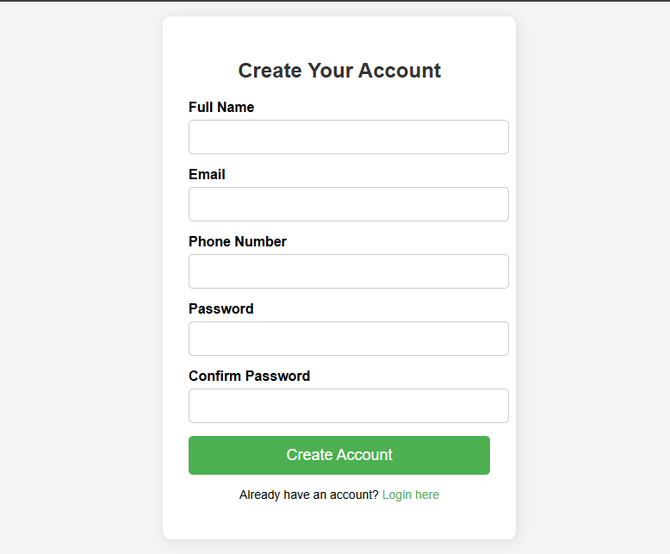
SIGNUP PAGE

Slide 14
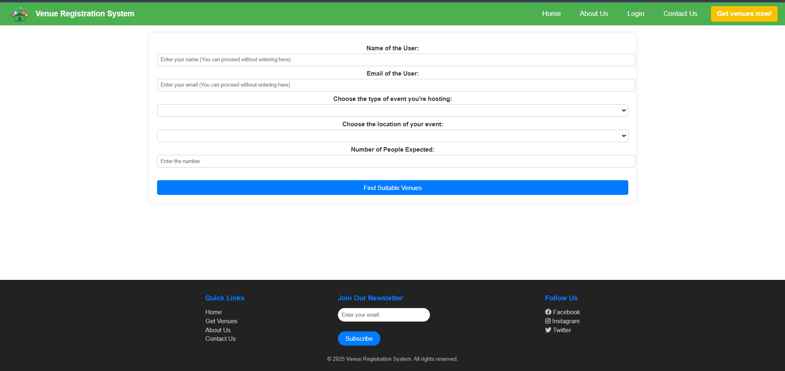
Venue Form filling page:

Slide 15
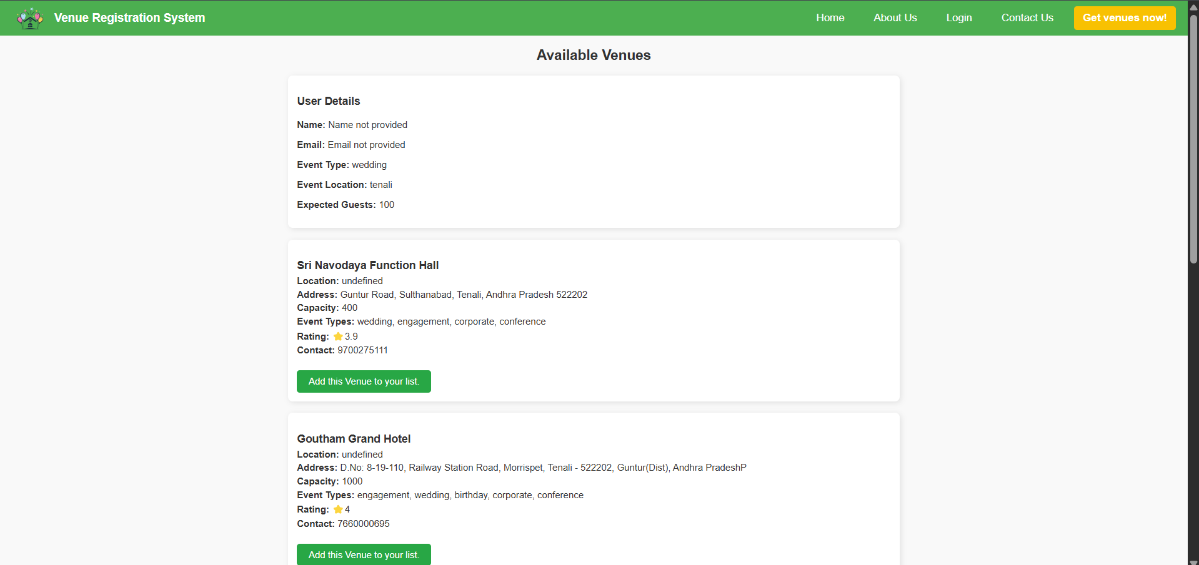
AFTER CLICKING FIND SUITABLE VENEUS OPTION THEN
THE DETAILS REGARDING THE AVAILABILITY OF VENUES IS DISPLAYED AS FOLLOWS
User credentials in login page

Slide 16
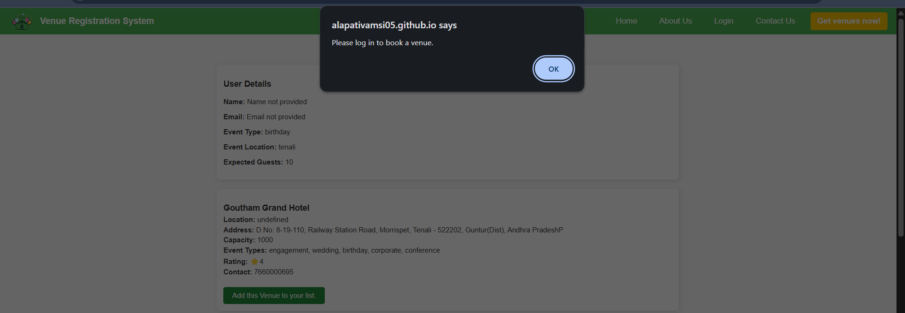
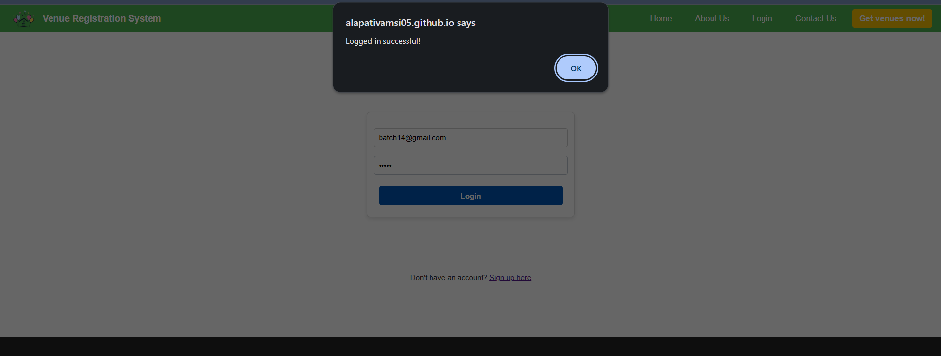
Prompting the user to login to book venues
User logging using an existing account

Slide 17
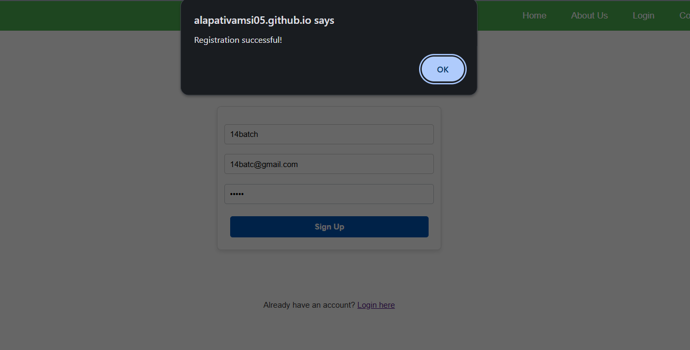
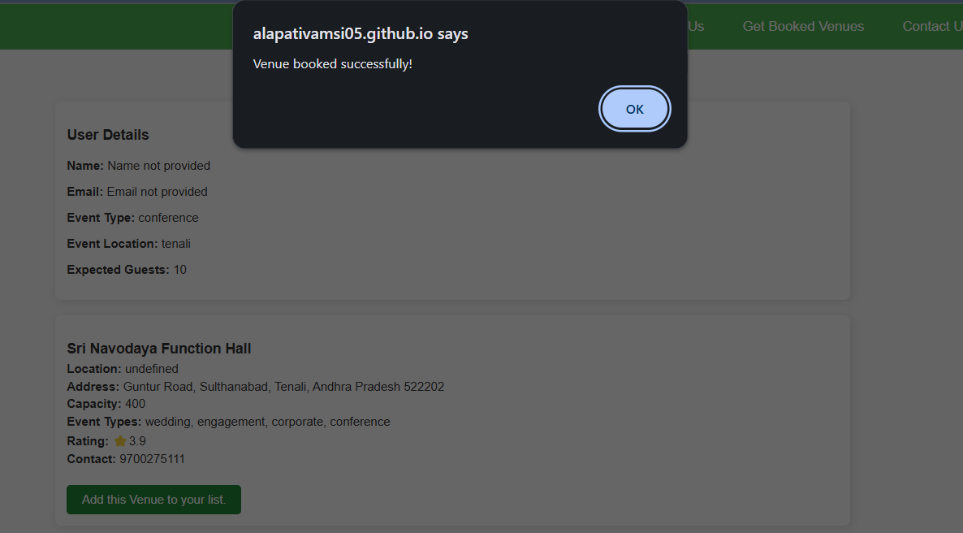
User creating a new account
Booking a venue

Slide 18
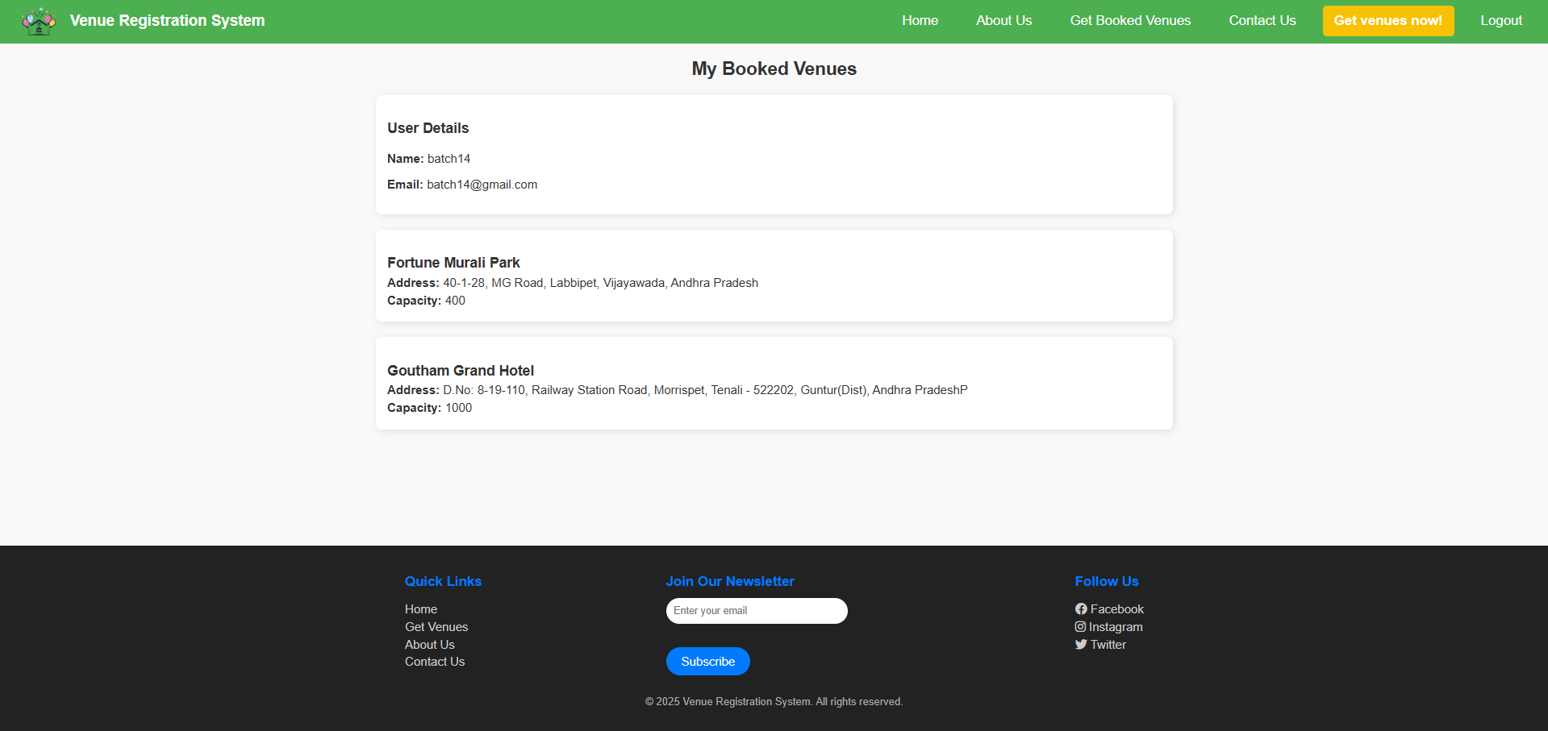
The previous bookings of the user

Slide 19

Conclusion:
Our Venue Registration System gives the most suitable venues as per the user’s preferences in a more efficient and with optimal results compared to the traditional method of manual searching, while also removing things such as logins, subscriptions that current venue registrations software ask for.
The ultimate goal is to provide a user-friendly interface for that makes searching more venues easier.

